Slide 1


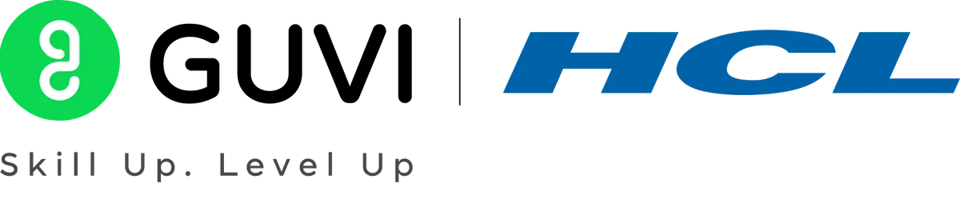

GUVI - Naan Mudhalvan
Engineering Hackathon 2025
www.guvi.in

Slide 2
RETAIL SHELF INVENTORY MANAGEMENT SYSTEM
Learning Programs
www.guvi.in

Slide 3
INTRODUCTION:
Learning Programs
Retail shelf inventory management plays a crucial role in ensuring product availability, optimizing stock levels, and enhancing the overall shopping experience. In physical retail environments, misplaced products and out-of-stock items can lead to lost sales, reduced customer satisfaction, and operational inefficiencies. Traditional manual methods of monitoring shelf inventory are often labor-intensive, error-prone, and lack real-time insights.
www.guvi.in

Slide 4
PROBLEM STATEMENT:
Learning Programs
Retail outlets face challenges in manually managing shelf inventory,resulting in product shortages and misplacements. Environmental variation like lighting and packaging design further complicate shelf monitoring.The need arises for an automated computer vision solution that continuously scan shelf,detect missing or misplaced products and issues timely restocking alerts.
www.guvi.in

Slide 5
OBJECTIVES:
1.Automate Shelf Monitoring To reduce manual effort by using image recognition or sensors to automatically monitor product presence and arrangement on store shelves.
2.Detect Misplaced Products To identify products that are not placed in their correct positions according to the store’s predefined planogram, helping maintain organization and brand compliance.
3.Trigger Restock Alerts To notify store staff when the quantity of a product on the shelf falls below a specified threshold, ensuring timely restocking and reducing out-of-stock incidents.
4.Enhance Inventory Accuracy To provide real-time, accurate data about shelf stock levels, reducing inventory discrepancies between what’s recorded and what’s actually available.
Learning Programs
www.guvi.in

Slide 6
ALGORITHM:
1.YOLOv8 Object detection
2.Contour Area Analysis
www.guvi.in

Slide 7
Tools:
1.opencv
2.numpy
3.matplotlib
Learning Programs
www.guvi.in

Slide 8
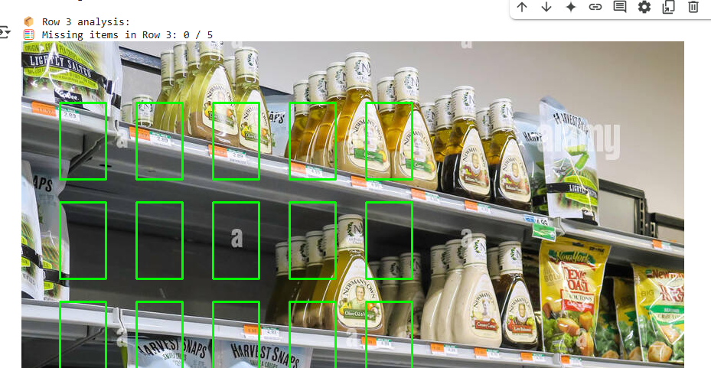
SAMPLE OUTPUT:
Learning Programs
www.guvi.in

Slide 9
CONCLUSION:
Learning Programs
The implementation of a Retail Shelf Inventory Management System significantly enhances operational efficiency, accuracy, and responsiveness in retail environments. By automating inventory tracking, reducing human error, and providing real-time data analytics, this system enables retailers to maintain optimal stock levels, prevent stockouts, and improve customer satisfaction. Additionally, it supports better decision-making by offering insights into product performance and shelf space utilization. As retail continues to evolve in a highly competitive market, adopting such a system becomes not only advantageous but essential for long-term profitability and sustainability.
www.guvi.in

Slide 10
Thank You
www.guvi.in

